Slide 1
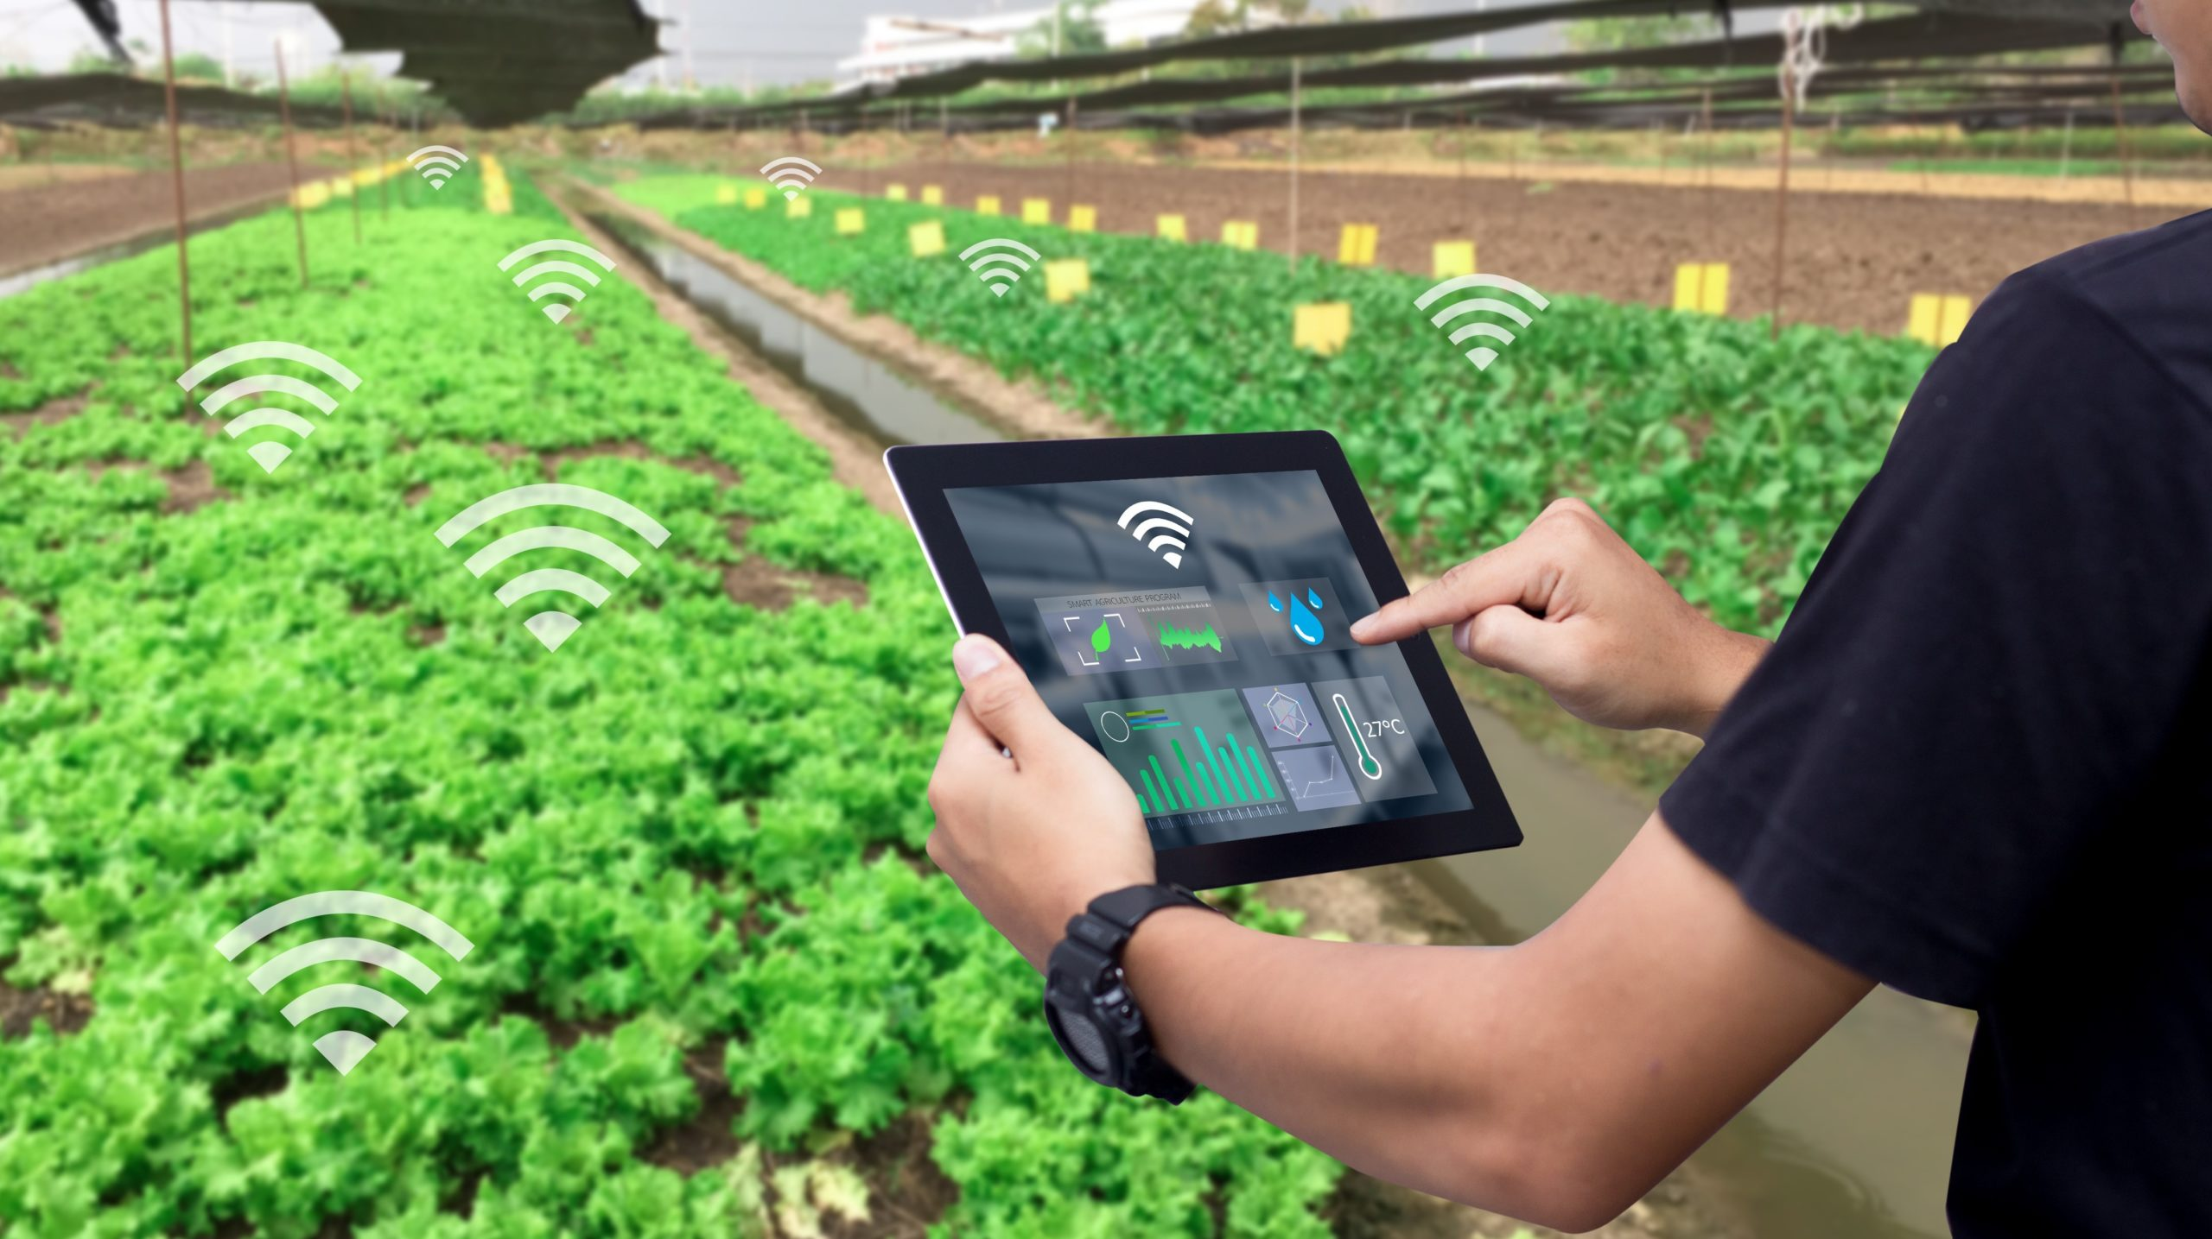
project guide: prof. gajanan tarte electronics department modern college of arts science and commerce shivajinagar PUNE presented by: LIMKAR AKASH APPASAHEB M.Sc II Roll No. 2103609
PROJECT IoT Based Plant Monitoring System

Slide 2
Introduction
IoT (Internet of Things) technology has revolutionized the way we interact with our environment and its applications have extended to various fields, including agriculture.
Thistechnology uses sensors, microcontrollers, and an IoT platform to collect and analyze data on plant growth and environmental conditions.
It has the potential to increase efficiency, reduce water usage, and improve crop yields in agriculture.

Slide 3
Components
ESP 32 Bit microcontroller
Temperature and Humidity sensor
Soil Moisture Sensor
12V DC Solonoid Valve
LCD 16x2
Blynk Application
Arduino IDE

Slide 4
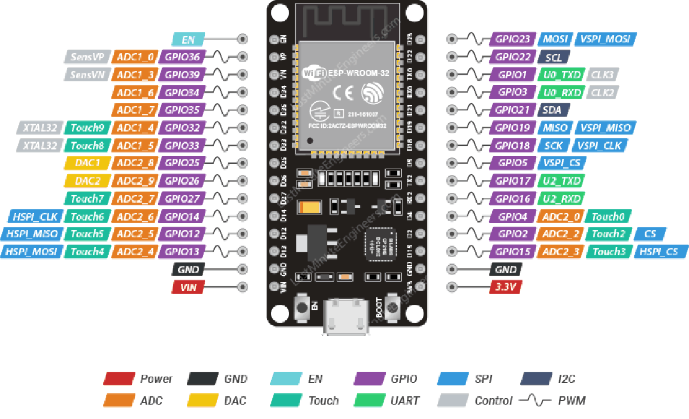
ESP32

Slide 5
Features of ESP32
34 programmable pins
ADC is 12 Bit and supports 15 channel
DAC is 8 Bit and supports 2 channels
Supports 4 SPI channels
Also supports UART channels
low power consumption
Supports Wi-Fi and Bluetooth

Slide 6
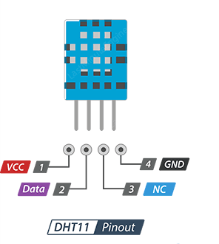
DHT11 Sensor
The DHT11 sensor uses a proprietary 1-wire protocol to transmit data, which means that it only requires a single digital pin to communicate with a microcontroller or other devices. It is commonly used in DIY projects and low-cost applications that require basic temperature and humidity sensing.
Operating voltage: 3.3V to 5V DC
Temperature measurement range: 0°C to 50°C
Sampling rate: 1 Hz (1 measurement per second)
Output signal: Digital signal via a single-wire serial interface
Dimensions: 12mm x 15.5mm x 5.5mm

Slide 7
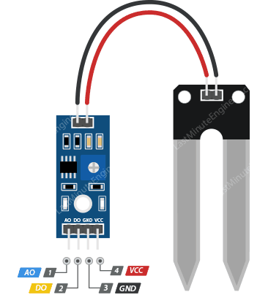
Soil Moisture Sensor
Soil moisture sensors are used to measure the amount of water in the soil. The theory behind soil moisture measurement is based on the fact that soil water content affects the electrical conductivity of the soil.
Resistive type of sensor
Operating voltage: Typically 3.3V to 5V DC
Soil moisture measurement range: 0 to 100% (Volumetric Water Content)
Output signal is digital

Slide 8
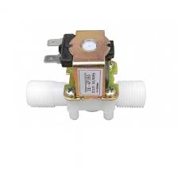
12V DC Solonoid Valve
It is commonly used in applications such as irrigation systems, water treatment plants, and automotive systems.
The valve typically consists of a solenoid, which is an electromechanical device that converts electrical energy into mechanical motion, and a valve body that controls the flow of fluid.
When a current is applied to the solenoid, it creates a magnetic field that pulls a plunger or armature, which opens or closes the valve.

Slide 9
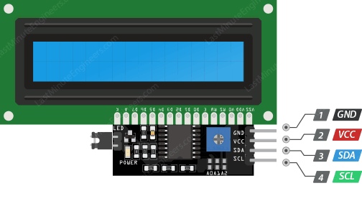
LCD 16x2
LCD module that has 16 character columns and 2 rows. This means that the display can show up to 16 characters horizontally and up to 2 rows vertically.
VCC
GND
SDA (Serial Data Pin)
SCL (Serial Clock Pin)

Slide 10
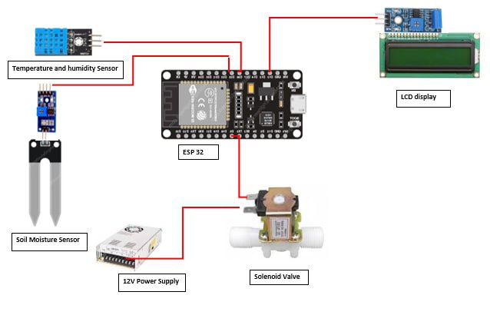
Circuit Diagram

Slide 11
Working
1. The soil moisture sensor measures the moisture content of the soil and sends the data to the ESP32 microcontroller.
2. The DHT11 sensor measures the temperature and humidity of the surrounding environment and sends the data to the ESP32 microcontroller.
3. The ESP32 microcontroller processes the data from both sensors and determines whether or not to turn on the water valve.

Slide 12
4. If the moisture level is too low and the temperature and humidity are within acceptable limits, the ESP32 turn offs the valve
5. The water valve opens and water flows to the plant.
6. The ESP32 also sends the data from both sensors to the LCD display.
7. Once the moisture level is sufficient, the ESP32 sends a signal to the relay module to turn off the water valve.
8. ESP32 is powered by a 5V DC power supply and Valve by 12V DC power supply

Slide 13
References
https://www.w3schools.com/c/
https://www.researchgate.net/publication/342175470_IoT_Based_Plant_Monitoring_System
https://lastminuteengineers.com/electronics/esp32-projects/
Neil Kolban, aKolban’s Book on ESP32,2017
https://blynk.io/
https://www.alldatasheet.com/view.jsp?Searchword=Esp32%20datasheet&gclid=Cj0KCQjw27mhBhC9ARIsAIFsETFXdiWjYSWsLeooLskVUYqmCER92js_HJ95KawV9WqTnSkq9WyRezsaArsSEALw_wcB
https://datasheetspdf.com/datasheet/search.php?sWord=dht11

Slide 14


THANK YOU

